Slide 1

ENERGY-EFFICIENT ROOF AND FLOORS
Name: Vaka Prasanna
Roll No: 20BQ1A05O6
Section: 4-CSE-D
Subject: Green Buildings
College: Vasireddy Venkatadri institute of technology

Slide 2
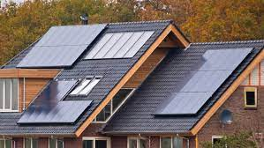
ENERGY-EFFICIENT ROOF AND FLOORS

Slide 3
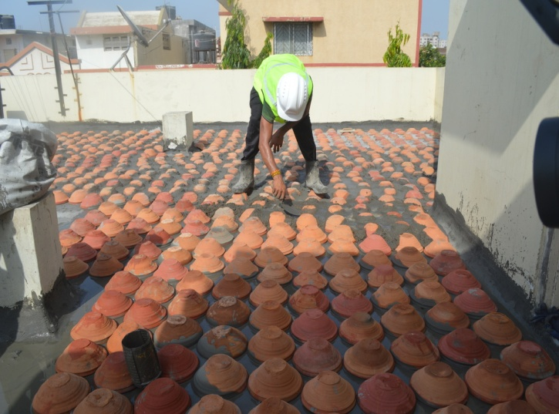
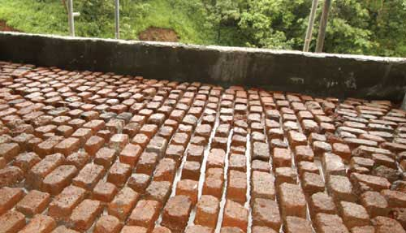
ENERGY-EFFICIENT ROOF AND FLOORS:
Inverted Earthen pot:
In this method roof is covered by inverted earthen pots, the top of earthen pot can be covered with a layer of earth or lime mortar finish or can be left uncovered.
By virtue of air trapped within them they provide good insulation. Earthen pots painted with white paints further reduce the heat load.
Pots made with earth are recyclable and locally/ regionally available.
Brick bat coba:
This system involves laying mortar with broken brick (which may be waste brick pieces) as aggregates and ground brick with lime or cement as binding matrix.
A thick mass of brick bats provide the thermal insulation for roof of the building.

Slide 4
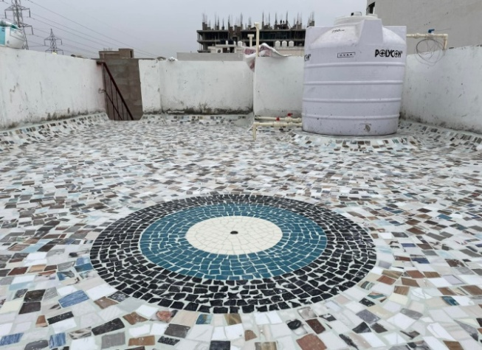
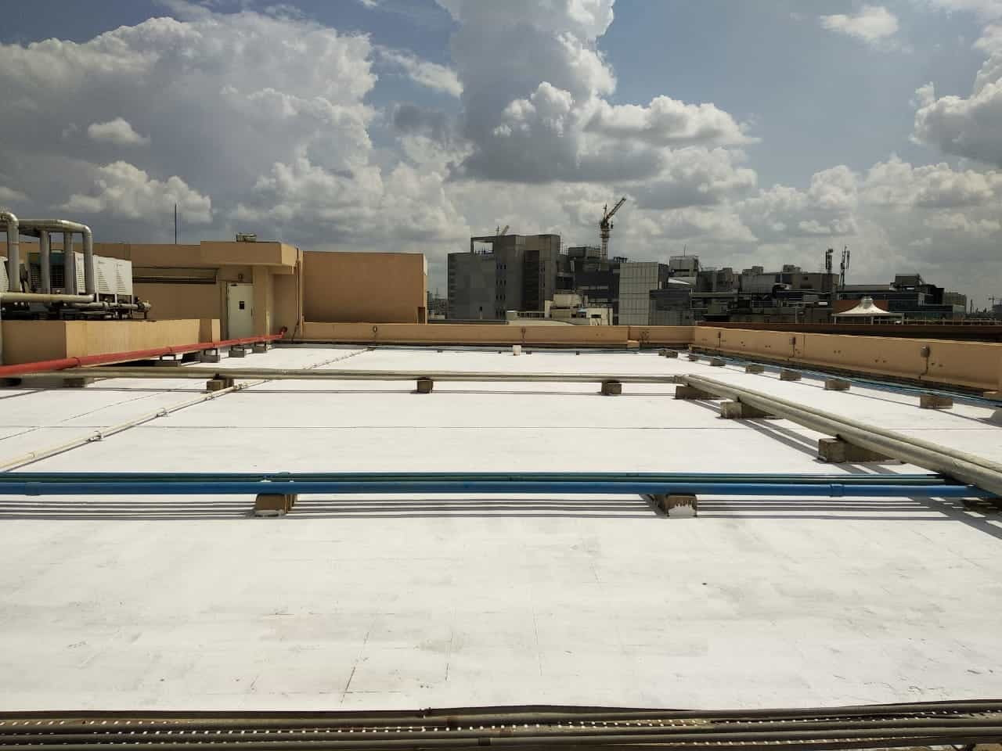
Broken ceramic mosaic tiles:
Broken ceramic tiles can be used as a cost effective external roof finish to reflect the incident solar radiation on the roof.
Broken ceramic light-colored tiles reflect heat off the surface because of high solar reflectivity and effectively utilize the waste ceramic tiles.
High SRI (Solar Reflective Index) Paints:
In recent development high thermal reflective paints are used for the exposed terrace areas which reflects incident heat and adds to the insulation values.
A roof which has received 2 coats of solar reflective paint will have a much lower surface temperature than one which has not had solar reflective paint applied.

Slide 5
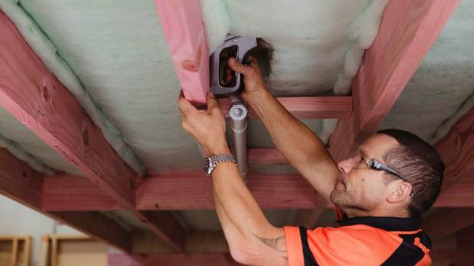
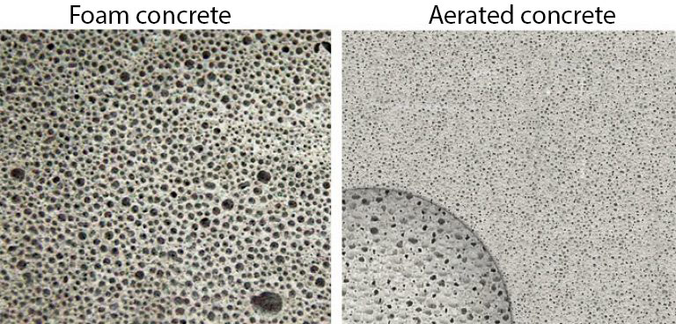
Underfloor Insulation:
It acts as a barrier, preventing cold air from seeping up from the ground or unheated spaces into living areas.
By placing insulating materials like rigid foam board homes can retain heat more effectively, enhancing energy efficiency, reducing heating costs, and increasing overall comfort during colder months.
USE OF LIGHT WEIGHT CONCRETE:
Preformed foam concrete may be considered for use for the leveling of floors, sprayed onto horizontal surfaces or in hollow cavities as light weight filler.

Slide 6

THANK YOU

